Slide 1

Advanced Programming Using Python
Anjali Kulkarni
Sept 2024

Slide 2
Day 2
Anjali Kulkarni
3 Sept 2024

Slide 3
Agenda
Revision
Nested loops
While
for
Match-case
Lists
Dictionaries
Tuples
Quiz

Slide 4
Hands on
Assignment 1: Write a program to calculate the sum of the digits of a given positive integer.
Input: Prompt the user to enter a positive integer.
Logic: Use a for loop to iterate through each digit of the number and calculate the sum.
Output: Display the sum of the digits.
Assignment 2: Write a program to generate and display the multiplication table of a given number up to 12.
Input: Prompt the user to enter a number.
Logic: Use a for loop to calculate and display the multiplication table for the number.
Output: Display the multiplication table.

Slide 5
Hands on
Assignment 3: Develop a program that simulates an ATM withdrawal process.
Input: Prompt the user to enter their account balance and the amount they wish to withdraw.
Logic:
Check if the withdrawal amount is greater than the account balance. If so, display an error message.
If the withdrawal amount is valid, subtract it from the balance.
Ensure the withdrawal amount is a multiple of 10 (as ATMs typically dispense money in multiples of 10).
Output:
Display the remaining balance if the withdrawal is successful.
If not, display an appropriate error message (e.g., "Insufficient balance" or "Amount must be a multiple of 10").
Check if user wishes to withdraw more money, else exit

Slide 6
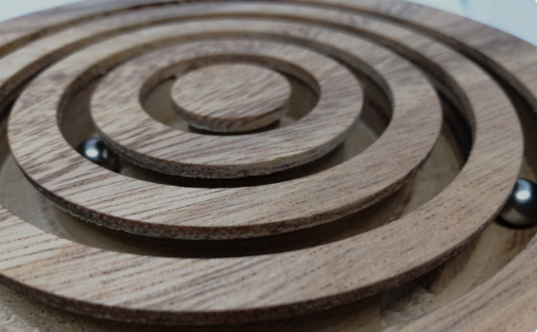
Nested loops (nestedwhileloop.py), (nestedForloop.py)
Nested for loop
Nested While loop
Else clause in loops

Slide 7
Hands on
Assignment 4:
Create Multiplication tables for 1 – 5 numbers using nested for loops

Slide 8
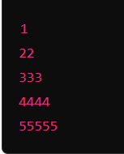
Hands on
Assignment 5 : Write a program to generate and display a triangular pattern of numbers based on user input using nested while loop
Input:
Prompt the user to enter the number of rows for the pattern (e.g., 4 for a pattern with 4 rows).
Output:
The program should display the pattern in a triangular format. For example, if the user inputs 5, the output should look like this:

Slide 9
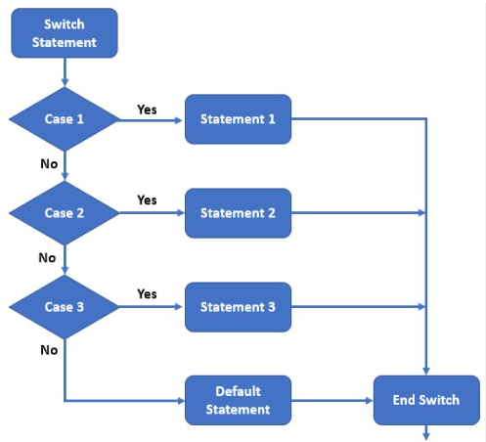
Match – case (matchCase.py)

Slide 10
Hands on
Assignment 6: Create a calculator for performing addition, subtraction, division, multiplication operations using match-case.
Input :
Ask user what operation needs to be performed.
Ask user if next operation needs to be performed. Based on the answer repeat same steps or exit.

Slide 11
Lists
Versatile data structure that stores an ordered collection of items
Mutable
Can hold elements of different data types
Allows duplicate data
Maintains order of insertion

Slide 12
List Operations (listOperations.py)
List is denoted by
empty_list = []
Accessing list Elements
Indexing
my_list[index]
Slicing a list
my_list[strtInd:endInd]
Modifying List
my_list[index] = new_value
Adding Elements
append()
insert()
extend()
Removing Elements
remove()
pop()
clear()
Copy List
copy()
Concatenation
‘+’ operator
Repetition
‘*’ operator
Membership
‘in’ , ‘not in’
Nested Lists
nested_list = [1, [2, 3], [4, 5, 6]]
List Methods
sort()
reverse()
index()
count()

Slide 13
Hands on
Assignment 8: Create a program that generates and stores all prime numbers up to a given number in a list.
Input:
Prompt the user to enter a positive integer n.
Logic:
Write a function that checks if a number is prime.
Use a loop to generate all prime numbers up to n and store them in a list.
Output:
Display the list of prime numbers.

Slide 14
Hands on
Assignment 9 : Write a program that implements a basic to-do list where users can add, remove, and view tasks.
Input:
Allow the user to add tasks to the to-do list.
Allow the user to remove tasks by specifying the task name.
Allow the user to view the current list of tasks.
Logic:
Use a list to store the tasks.
Implement a loop that continuously prompts the user to choose an action (add, remove, view, or exit).
Output:
Display the updated to-do list after each operation.

Slide 15
Hands on
Assignment 10: Write a program that rotates a given list to the right by a specified number of positions.
For e.g. : If list is [1, 2, 3, 4, 5] and number of positions is 2, then rotated list should be [4, 5, 1, 2, 3].
Input:
Prompt the user to enter the elements of the list, separated by spaces or commas (e.g., 1 2 3 4 5).
Prompt the user to enter the number of positions to rotate the list to the right.
Calculation:
Rotate the list to the right by the specified number of positions. If the number of positions exceeds the length of the list, use modulo operation to handle this case.
Output:
Display the original list and the rotated list.
Requirements:
Ensure that the rotation handles cases where the number of positions is greater than the length of the list.

Slide 16
Tuples
Stores ordered collection of elements
Immutable lists
Ordered
Heterogeneous
Memory efficient
Faster than lists

Slide 17
Tuple operations (TupleFunctions.py)
Tuple is denoted by
empty_tuple = ()
Accessing Tuple Elements
Indexing
my_tuple[ind]
Slicing a tuple
my_tuple[strtInd:endInd]
Concatenation
‘+’ operator
Repetition
‘*’ operator
Membership
‘in’ , ‘not in’
Built-in methods
Count(item whose occurrence is to be deduced)
Index(item whose index is to be deduced)
Tuple Unpacking
item1, item2, item3 = my_tuple
Nested Tuples
nested_tuple = (1, (2, 3), (4, 5, 6))
Converting tuples to Lists

Slide 18
Hands on
Assignment 11: Tuple Manipulation
Input:
Prompt the user to enter a list of elements separated by commas (e.g., 10, 20, 30, 40, 50).
Tasks:
Convert the input string to a tuple of integers.
Perform the following operations and display the results:
Print the first element of the tuple.
Print the last element of the tuple.
Print tuple excluding first and last elements (slice of tuple from second to second-to-last element).
Print every second element of the tuple (i.e., slicing with a step).
Print the tuple reversed (i.e., use slicing to reverse the tuple).
Output:
Display results of the above operations in a clear format.

Slide 19
Hands on
Assignment 12: Develop a program that demonstrates tuple packing and unpacking, including nested tuple unpacking.
Input:
Prompt the user to enter three pieces of information: name (string), age (integer), and a nested tuple containing city and country (strings).
Logic:
Pack these pieces of information into a single tuple.
Unpack the tuple back into individual variables.
Display the unpacked variables, including the elements of the nested tuple.
Output:
Display the packed tuple and the unpacked values.

Slide 20
Hands on
Assignment 13: Tuple Statistics
Instructions:
Perform following tasks:
Prompt the user to enter a tuple of integers separated by commas (e.g., 5, 10, 15, 20).
Convert the input string to a tuple of integers.
Calculate and display:
The sum of all elements.
The average of the elements.
The maximum and minimum values.
The number of elements in the tuple.
Output:
Display results of the above operations in a clear format.

Slide 21
Hands on
Assignment 14: Tuple Sorting and Filtering
Instructions:
Perform the following tasks:
Prompt the user to enter a tuple of integers separated by commas (e.g., 8, 3, 7, 1, 4).
Convert the input string to a tuple of integers.
Sort the tuple in ascending order.
Filter out all elements greater than a specified threshold (prompt the user for this threshold).
Display the sorted tuple and the filtered elements.
Output:
Display results of the above operations in a clear format.

Slide 22
Dictionaries
Data structures that store data in key-value pairs
Mutable
Powerful and flexible
Storing and managing complex data
Dictionaries are indexed by unique keys

Slide 23
Dictionary Operations
del
Dictionary is denoted by
empty_dict = {}
Accessing dict Elements
Using keys
my_dict[key]
Using get()
my_dict.get("age“)
Removing key value pairs
pop()
popitem()
del()
clear()
Modifying List
Adding key value pairs
my_dict[“key”] = [newVal1,newValn]
Checking for Key Existence
‘in’ , ‘not in’
Directory Methods
keys()
Values()
Items()
Copying Directories
copy()

Slide 24
Dictionary Keys
Valid Keys:
Strings:
my_dict = {"key": "value"}
Numbers:
my_dict = {1: "one", 2: "two"}
Tuples:
my_dict = {(1, 2): "pair"}
Invalid Keys:
Lists:
my_dict = {[1, 2]: "list"} # Raises a TypeError
Dictionaries:
my_dict = {{1: 2}: "dict"} # Raises a TypeError

Slide 25
Hands on
Assignment 15: Create a program that stores and analyses student’s grades using dictionaries.
Input:
Prompt the user to enter student names and their corresponding grades.
Store the data in a dictionary where keys are student names and values are lists of grades.
Logic:
Implement functions to:
Calculate the average grade for each student.
Find the student with the highest average grade.
Display students who have grades above a certain threshold.
Output:
Display each student's average grade.
Display the student with the highest average grade.
Display the list of students with grades above a user-specified threshold.

Slide 26
Hands on
Assignment 16: Develop a program to manage an inventory system for a small store.
Input:
Prompt the user to enter items, their quantities, and prices.
Store the data in a dictionary where keys are item names, and values are another dictionary containing quantity and price.
Logic:
Implement functions to:
Add new items to the inventory.
Update the quantity or price of existing items.
Calculate the total value of the inventory (sum of all items' value = quantity * price).
Output:
Display the current inventory.
Display the total value of the inventory.

Slide 27
Hands on
Assignment 17: Create a country capitals quiz program using dictionaries.
Input:
Store a dictionary of countries and their capitals.
Ask the user to match countries with their capitals.
Logic:
Implement a function to shuffle the questions and keep track of correct and incorrect answers.
Allow the user to take the quiz and provide feedback after each question.
Calculate the final score.
Output:
Display the correct answer when the user gets it wrong.
Show the final score and a summary of correct and incorrect answers.

Slide 28
Hands on
Assignment 18: Build a simple phonebook application using dictionaries.
Input:
Allow the user to add, search, update, and delete contacts in the phonebook.
Each contact should have a name, phone number, and email.
Logic:
Use a dictionary where keys are contact names and values are another dictionary containing the phone number and email.
Implement functions for adding, searching, updating, and deleting contacts.
Ensure the phonebook is case-insensitive when searching for contacts.
Output:
Display all contacts after each operation.
Display a message if a contact is not found during a search or delete operation.

Slide 29
Hands on
Assignment 19: Write a program that counts the frequency of each element in a list and stores the results in a dictionary.
Input:
Prompt the user to enter a list of elements (numbers, strings, etc.).
Logic:
Use a loop to count the occurrences of each element in the list.
Store the element and its frequency as key-value pairs in a dictionary.
Output:
Display the dictionary with the frequency of each element.

Slide 30
Hands on
Assignment 20: Create a program to manage a book collection using dictionaries.
Input:
Allow the user to add, remove, and search for books in the collection.
Each book should have a title, author, genre, and year of publication.
Logic:
Use a dictionary where keys are book titles and values are another dictionary containing the author, genre, and year.
Implement functions to:
Add a new book to the collection.
Remove a book from the collection by title.
Search for books by genre or author.
Display all books in the collection.
Output:
Display the details of all books in the collection after each operation.
Display search results for books by genre or author.

Slide 31


Slide 32
Thank You !!

Slide 33
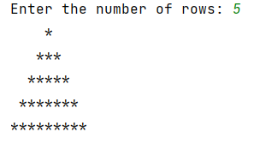
Homework
Assignment 1: Write code to print a pyramid of stars in ascending order. Accept number of rows from user.
Sample output:

Slide 34
Homework
Assignment 2: Create a calculator for performing addition, subtraction, division, multiplication operations using match-case.
Input :
Ask user what operation needs to be performed.
Ask user if next operation needs to be performed. Based on the answer repeat same steps or exit.

Slide 35
Homework
Assignment 3 : Write a program that calculates and displays a student's final grade based on the scores of different assignments and exams.
Input:
Prompt the user to enter the student's name.
Prompt the user to enter the scores (as floats) for different assignments (e.g., homework, quizzes, midterm, final exam).
Calculation:
Calculate the final grade as a weighted average (e.g., Homework 20%, Quizzes 20%, Midterm 30%, Final Exam 30%).
Convert the final grade to a percentage.
Output:
Display the student's name, their final grade as a percentage, and the corresponding letter grade (A, B, C, D, F).

Slide 36
Homework
Assignment 4: Repeat specific elements within a tuple.
Instructions:
Write a Python program that performs the following tasks:
Prompt the user to enter a tuple of elements (mixed types allowed) separated by commas.
Convert the input string to a tuple of elements.
Prompt the user for an element to repeat and the number of times to repeat it.
Create a new tuple where the specified element is repeated the given number of times, with the rest of the elements unchanged.
Display the original tuple and the new tuple.

Slide 37
Homework
Assignment 5: Develop a Python program to read a text file, extract all unique words, and save them in alphabetical order to a new file.
Input: A text file containing multiple lines of text.
Logic:
Read the entire file into a list of lines.
Split each line into words and store them in a list.
Convert the list to a set to remove duplicates, then sort the set alphabetically.
Write the sorted unique words to a new file named unique_words.txt.
Output: Display the unique words and confirm they have been saved to the file

